Slide 1

DATA 606 Capstone in Data Science
Wealth and Population Density Influences
on COVID-19 Cases and Vaccinations
Using Machine Learning
Phase II – Exploratory Data Analysis & Model Construction
Ken Noppinger
E-mail: knoppin1@umbc.edu

Slide 2
Exploratory Data Analysis (continued from Phase I)
Recap Phase I activities…
Wealth, Population, and COVID-19 data sets cleaned and merged
Preliminary EDA showed correlations to investigate as:
Population Per Square Mile and Cases Per Square Mile
Income and Vaccination Percentages
EDA also suggested refining focus on county data at state level rather than full set of over 3K counties in United States.
Focus states chosen:
California (58 counties)
Florida (67 counties)

Slide 3
EDA - Choropleth Maps
Choropleth maps visualize variation in a feature geographically
Features explored for both California and Florida counties
Population Density (people per square mile)
COVID-19 Case Density (cases per square mile)
Median Incomes
COVIS-19 Vaccination Percentages

Slide 4
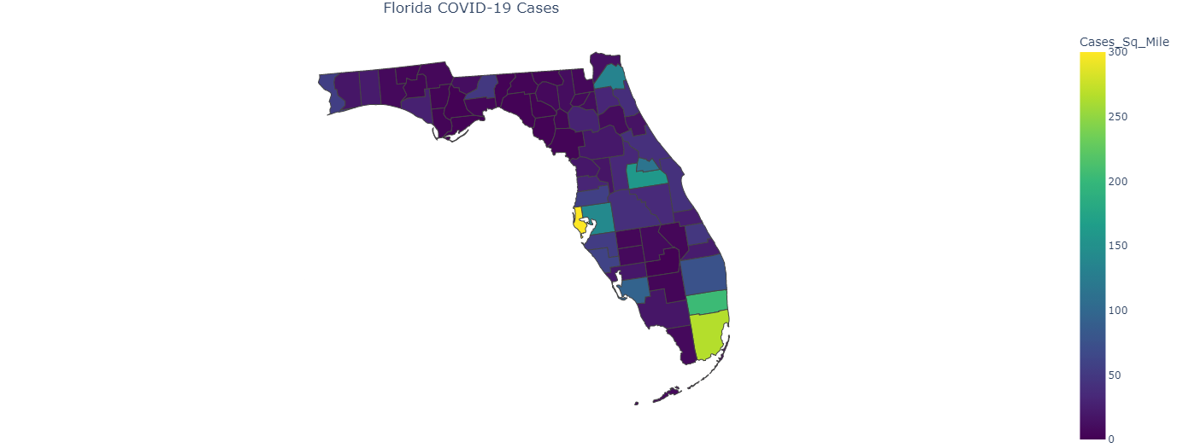
Choropleth Map - sample
Highest COVID-19 case density in Miami, Tampa, Orlando, and Jacksonville areas

Slide 5
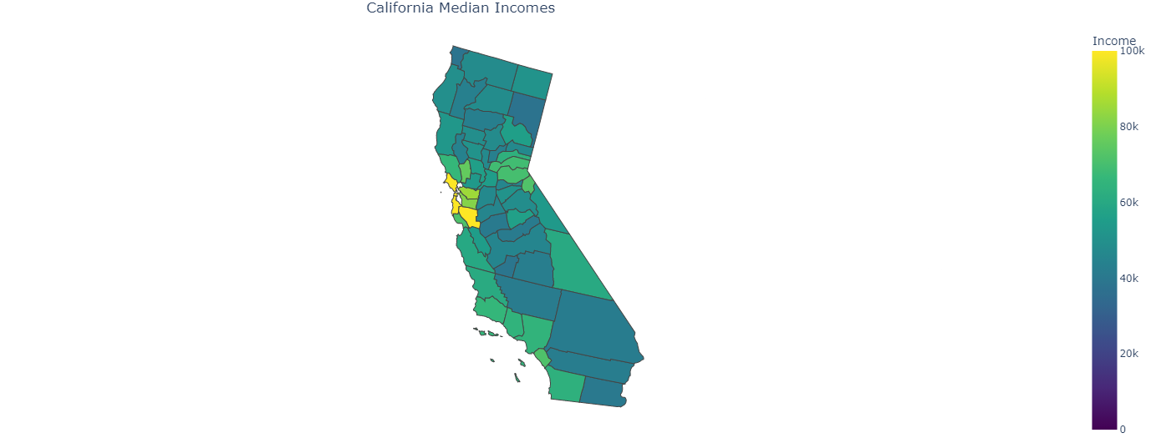
Choropleth Maps - Sample
Highest Incomes in San Francisco Bay area counties

Slide 6
EDA – Scatter/bubble charts
Scatter charts with a bubble effect allow for comparing three features together
Features explored for both California and Florida counties
Population Density by Income and COVID Vaccinations
COVID-19 Case Density by Income and Population Density

Slide 7
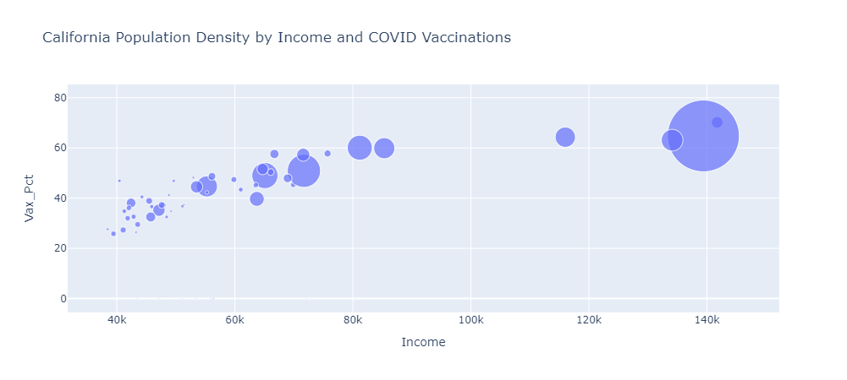
SCATTER/BUBBLE CHART - Sample
Linear pattern reflected on chart
Vaccination percentage and population density increasing as income rises.

Slide 8
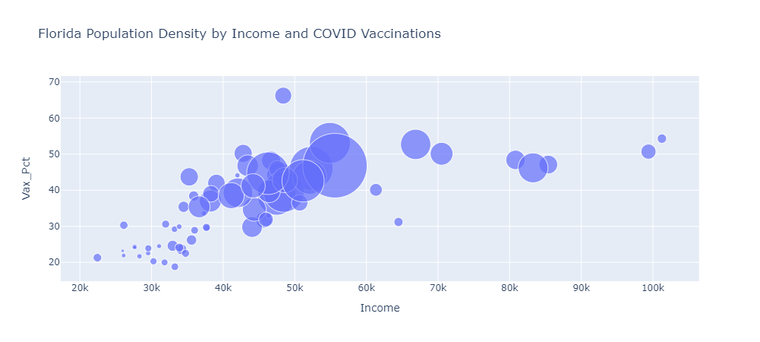
SCATTER/BUBBLE CHART - Sample
Linear pattern reflected on chart
Reinforces vaccination percentage increases with income level
Population density is a driver for vaccinations up to middle income.

Slide 9
K-Means Model construction
Correlations of concern:
Population Density and Case Density
Median Income and Vaccination Percentages
K-Means clustering
Correlations for both correlations on separate Florida and California data sets
Correlations for both correlations on combined Florida and California data set

Slide 10
K-Means Model construction
Approach / Algorithm
Filter data to counties in subject state(s)
Scale features using StandardScaler
Loop ten (10) times to determine optimal clusters using Elbow Method
Define K-Means clustering model (run for 10 different initial centroids)
Fit the model with the scaled features
Plot the WCSS (within cluster sum of squares) to show the elbow
Define the K-Means model for the optimal K (i.e., number of clusters)
Fit and predict cluster labels using the scaled features
Scatter plot and choropleth map the resulting clusters

Slide 11
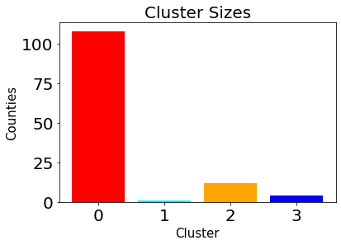
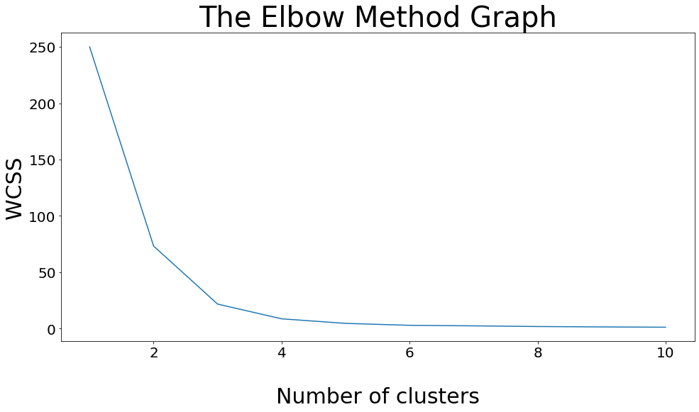
K-Means Model Execution - SAMPLE
California and Florida Counties:
K-Means -- Population Density and COVID-19 Case Density
Optimal K – 4 clusters
Inertia - 8.7
Convergence – 4 iterations

Slide 12
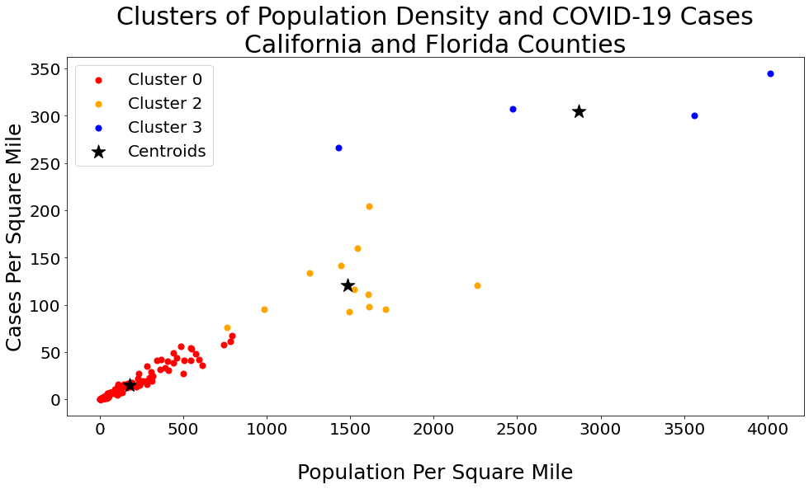
K-Means Model Execution - SAMPLE
Note: Cluster 1 was removed since it represented a single county outlier (SF) and skewed the visualization.

Slide 13
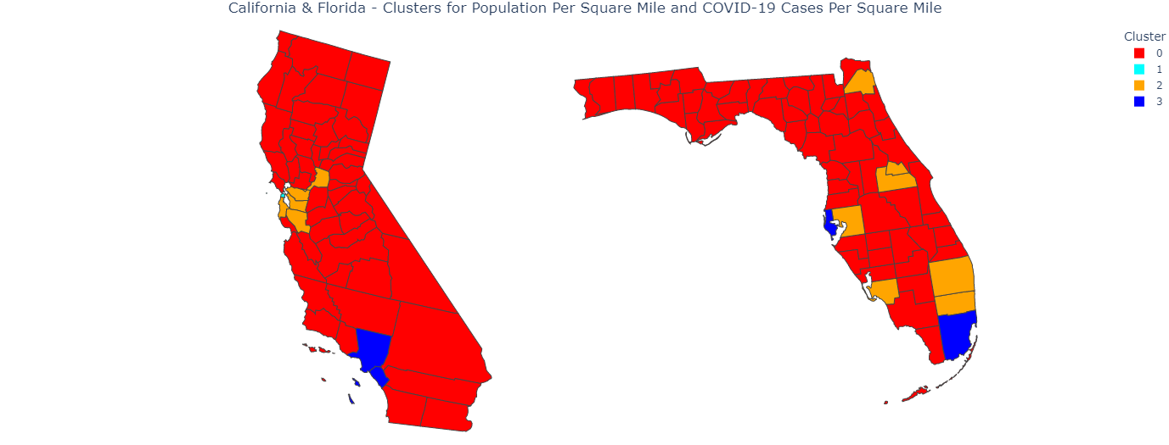
K-Means Model Execution - SAMPLE
Cyan county (i.e., SF outlier) indicates most significant concern area with highest population and case densities.
Otherwise, blue and orange counties reflect other areas of concern for same reason.

Slide 14
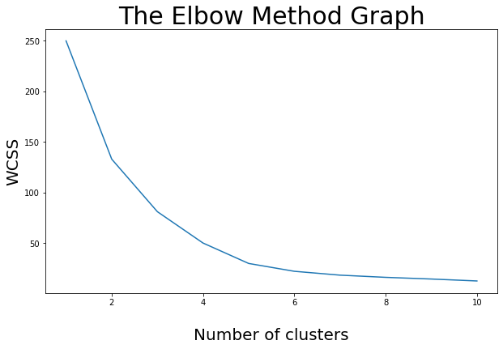
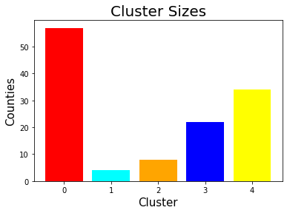
K-Means Model Execution - SAMPLE
California & Florida Counties
K-Means -- Median Income and COVID-19 Vaccination Percentage
Optimal K – 5 clusters
Inertia – 29.9
Convergence – 7 iterations

Slide 15
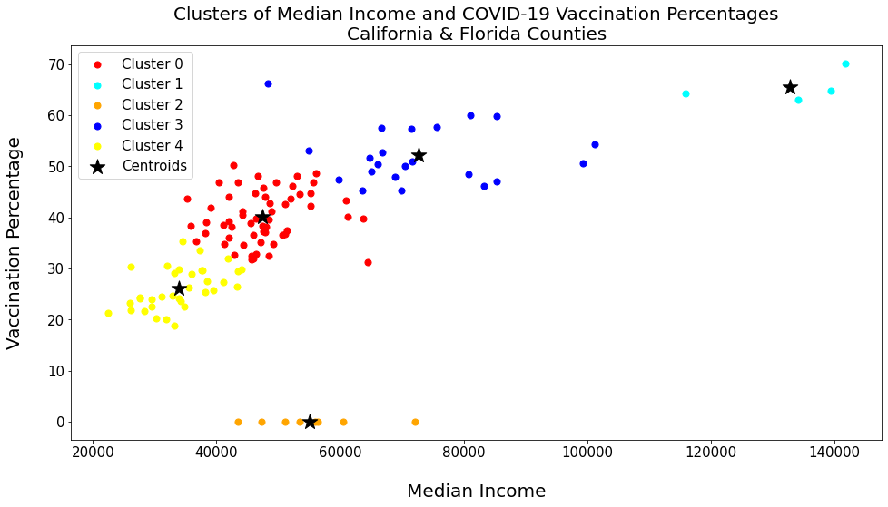
K-Means Model Execution - SAMPLE
Distinct linear pattern in the clusters and grouping show vaccinations increase as income rises
Majority of counties (shown in red) reflect middle income / middle vaccination percentage

Slide 16
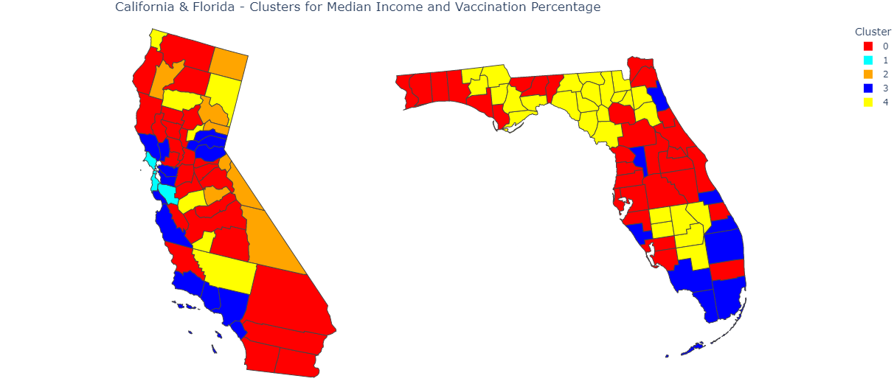
K-Means Model Execution - SAMPLE
Yellow counties have lower income with lower vaccination percentages
Cyan and Blue counties are wealthier with higher vaccination percentages.
Orange counties appear to have not reported vaccinations to the CDC.

